Slide 1
“The Law”
How God Remedied The Defects of the Law
(part 4a)
All verses are from the New King James Version unless noted.
Notes:
Influenced by the thoughts expressed by Alexander Campbell in his famous sermon on the Law.

Slide 2
Previously
No divisions of the law were understood by apostles
What the Law Could Not Do
Why the Law could not accomplish life and righteousness
A look at the allegory of Hagar and Sarah

Slide 3
Today
How God Remedied The Defects of the Law:
  The Law was not a suitable rule of life for all mankind
  The Law could not exhibit the full scope of the malignity of sin
  The Law could not impart life and righteousness
TODAY’S
SUBJECT
All of the defects within the law are remedied through the Father sending His Son in the likeness of sinful flesh (Rom. 8:3)

Slide 4
The Law
It was not suitable for all men everywhere to keep
  the practice of many of its laws were given to a specific and limited locality of the world – Jerusalem (Deut. 16:16; 2 Chron. 6:6)
Though its purpose was high and good, it could not make those perfect who lived under it (Rom. 7:12, 13)
  “For what the law could not do in that it was weak through the flesh…” (Rom. 8:3)
  “for the law made nothing perfect…” (Heb. 7:19)
The sacrifices of the law were too weak to atone for sin (Heb. 10:4)

Slide 5
Law Limited by Christ’s Teaching
Christ taught the limited nature of the Law
“For all the prophets and the law prophesied until John” (Matt. 11:13)
  “For till John appeared, all the prophets and the law were your instructions:” (Matt. 11:13, LO)
“The law and the prophets were until John. Since that time the kingdom of God has been preached, and everyone is pressing into it” (Lk. 16:16)
  The law and the prophets prophesied of the kingdom
  When John arrived he preached that it was “at hand” (Matt. 3:1, 2)
(1)

Slide 6
Law Limited by Prophecy
Malachi closed the Old Testament telling people to keep the law of Moses and to look for the prophet who was to come in the power of Elijah (Mal. 4:4-6)
Malachi
John the Baptist
Jesus Christ
4:4-6
Lk. 1:17; Matt. 17:10-13
John 1:29-34
(2)
Notes:
The law was looking forward to John by the spirit of the prophecy of Malachi and John looked and pointed toward Jesus. Hence the law looked to Jesus through prophecy and John.

Slide 7
Law Limited by the Father
Jesus
Moses
Elijah
Moses and Elijah were sent to resign their glories to the feet of Jesus the Christ
Matthew 17:1-8
"This is My beloved Son, in whom I am well pleased. Hear Him!"
(3)

Slide 8
Law Limited by the Father
Jesus
Moses
Elijah
Jesus, our Lawgiver and prophet, gave a law & covenant suitable for all people everywhere!
James 4:12
Acts 7:37
Luke 7:16
Matthew 17:1-8
"This is My beloved Son, in whom I am well pleased. Hear Him!"
(3)
Notes:
Might read Luke 7:11-16 with emphasis being on v. 16.

Slide 9
Ephesians 2:14, 15, “For He Himself is our peace, who has made both one, and has broken down the middle wall of separation, having abolished in His flesh the enmity, that is, the law of commandments contained in ordinances, so as to create in Himself one new man from the two, thus making peace”
Colossians 2:14, “having wiped out the handwriting of requirements that was against us, which was contrary to us. And He has taken it out of the way, having nailed it to the cross”
Hebrews 7:18, “For on the one hand there is an annulling of the former commandment because of its weakness and unprofitableness”
We have a new covenant that was not according to the covenant made on Sinai (Heb. 8:8, 9, 13)

Slide 10
No More!
Repetitive animal blood on an altar for sin (Acts 20:28; Heb. 9:12)
Sabbath day restrictions (Col. 2:16, 17)
Dietary restrictions (1 Tim. 4:4)
Jerusalem as the place of worship
  local churches of Christ (Jn. 4:24; 1 Cor. 11:18; Acts 20:6, 7)
Special class of people for priesthood
  all Christians are priests (1 Pet. 2:7)
Mortal high priests (Heb. 7:12, 23-25)
“…And He has taken it out of the way, having nailed it to the cross” (Col. 2:14)

Slide 11
The gospel of Christ is the suitable law for all mankind!
  It was to be preached to every creature of every nation under heaven (Mk. 16:15; Matt. 28:18, 19; Acts 1:8)
    It was preached to every creature under heaven (Col. 1:23)
  Men and women from all over the world obeyed it (Acts)
  Churches of Christ were planted all over the world by men and women following the pattern of Christ through the apostles (Phil. 3:17; Rom. 16:16; 1 Thess. 2:13-14)
  Do not be a member of a church that is not imitating the church of Christ that you read about in the Bible!

Slide 12
Not Just Any Faith Or Church (Eph. 4:4-6)
Jehovah Witness –Claims to be Jehovah’s witness but do not believe the witness that Jesus is Jehovah

Slide 13
Not Just Any Faith Or Church (Eph. 4:4-6)
Claims to be Jehovah’s witness—but then not believe the witness that Jesus is Jehovah
  “A voice is crying — in a wilderness — Prepare ye the way of Jehovah, Make straight in a desert a highway to our God” (Is. 40:3, YLT; cf. Mal. 3:1)
    Prepare the way of Jehovah –to our God
    John was the voice crying which prepared the way for Jehovah, our God (Jn. 1:23)
    For Whom was John preparing the way? Who came?
    Therefore Jesus is Jehovah (as the Father and Spirit are)

Slide 14
Not Just Any Faith Or Church (Eph. 4:4-6)
Jehovah Witness –Claims to be Jehovah’s witness but do not believe the witness that Jesus is Jehovah
Baptist –Claims baptism but not for the remission of sins
Seventh-Day Adventist –prefers an Old Testament day for the Lord’s day

Slide 15
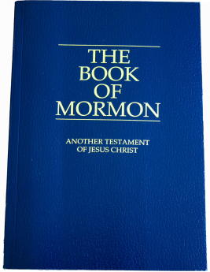
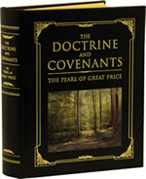
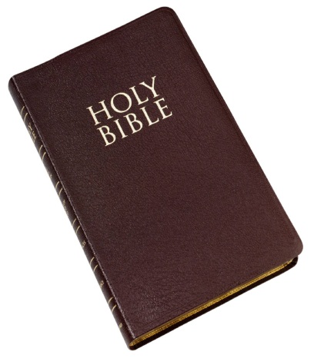
“You shall not add to the word which I command you…” (Deut. 4:2)
Mormon—Claims to be “of Jesus Christ,” but:
  Adds the BOM to the scriptures (Deut. 4:2; Rev. 22:19)
  Places the Aaronic priesthood in the church (Heb. 7:11, 12)
  Has mortals ordained to the priesthood of Melchizedek (elders, high priests, patriarchs, apostles)
+
+
1830
1835
???
NOT

Slide 16
Some Distinguishing Marks of the Early Church
They preached that the penitent believer must be baptized to be saved (Acts 2:38)
They preached that Jesus Christ is the Son of God (Matt. 1:23; Mk. 1:1; Rom. 1:4; Titus 2:13; etc.)
  Distinct from the Father, distinct from the Holy Spirit, not an angel, not only a man
They preached the separation of the covenants and that we are under the New Covenant (2 Cor. 3:6; Mk. 14:24; Heb. 8:8, 13; 9:15; 10:9; 12:24)
They praised God without musical instruments (Heb. 13:15; Eph. 5:19)

Slide 17
Some Distinguishing Marks of the Early Church
They gave of their means on the first day of the week (1 Cor. 16:1-3)
They partook of the Lord’s Supper as often as they gave—on the first day of the week (Acts 20:7)
They believed in the resurrection of the dead and of judgment to come (Acts 24:15)
They believed in the terror of hell fire (2 Thess. 1:8, 9; 2 Cor. 5:11)
They believed in the reward of heaven and the coming of our Lord (Lk. 18:22; Jn. 14:1, 2; Acts 1:10, 11; 2 Cor. 5:2)
They believed that a person could be saved and yet sin so as to be lost (Heb. 3:12-14; Gal. 5:4; Rev. 2:10; etc.)

Slide 18


Is The Church You Are A Member Of Hitting Or MISSING
The Mark Of New Testament Christianity?

